Slide 1
Bert Explanation

Slide 2
Why do we need Bert?

Slide 3
BERT is designed to help computers understand the meaning of ambiguous language (Can have multiple interpetation) in text by using surrounding text to establish context.
Ex for ambiguous language
“I went to the bank.” (The bank could be a place where money is kept, or it could be the edge of a river.”
“I sent the bill to John.” (The bill could be the amount of money John owed or it could be the bill for a cap so John, who repairs caps, can repair one.)

Slide 4
Why bert is so great?

Slide 5
BERT is pre-trained on a large corpus of unlabelled text including the entire Wikipedia(that’s 2,500 million words!) and Book Corpus (800 million words)
BERT is able to account for a word’s context. Previous methods of word-embedding would return the same vector for a word no matter how it is used, while BERT returns different vectors for the same word depending on the words around it.
Bert is a open source.

Slide 6
What is Bert?

Slide 7
BERT stands for Bidirectional Encoder Representations from Transformers
BERT is a “deeply bidirectional” model. Bidirectional means that BERT learns information from both the left and the right side of a token’s context during the training phase
Historically, language models could only read text input sequentially -- either left-to-right or right-to-left -- but couldn't do both at the same time. BERT is different because it is designed to read in both directions at once. This capability, enabled by the introduction of Transformers, is known as bidirectionality.

Slide 8
To put it in simple words BERT extracts patterns or representations from the data or word embeddings by passing it through an encoder. The encoder itself is a transformer architecture that is stacked together. It is a bidirectional transformer which means that during training it considers the context from both left and right of the vocabulary to extract patterns or representations.

Slide 9
How bert works?

Slide 10
BERT was pre-trained with two specific tasks: Masked Language Model and Next sentence prediction. The former uses masked input like “the man [MASK] to the store” instead of “the man went to the store”.
This restricts BERT to see the words next to it which allows it to learn bidirectional representations as much as possible making it much more flexible and reliable for several downstream tasks.
The latter predicts whether the two sentences are contextually assigned to each other.

Slide 11
To get BERT working with your data set, you do have to add a bit of metadata.
For instance, if sentence A is “[CLS] the man [MASK] to the store” and sentence B is “penguin [MASK] are flightless birds [SEP]”, then BERT will be able to classify whether both the sentences are continuous or not.
During the training, BERT uses special types of tokens like [CLS], [MASK], [SEP] et cetera, that allow BERT to distinguish when a sentence begins, which word is masked, and when two sentences are separated.

Slide 12
Token | Purpose
[CLS] | The first token is always classification
[SEP] | Separates two sentences
[END] | End the sentence
[PAD] | Use to truncate the sentence with equal length
[MASK] | Use to create a mask by replacing the original word

Slide 13
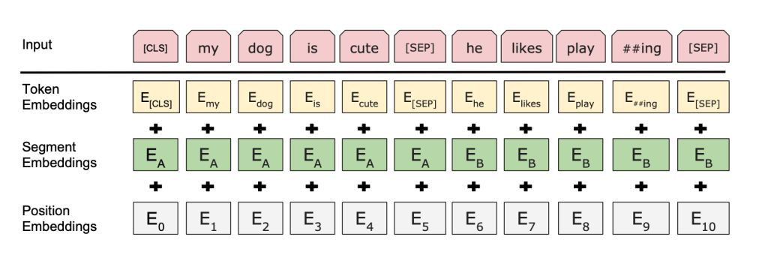
Every input embedding is a combination of 3 embeddings

Slide 14
What is token embedding?
For instance, if the sentence is “The cat is walking. The dog is barking”, then the function should create a sequence in the following manner: “[CLS] the cat is walking [SEP] the dog is barking”.
After that, we convert everything to an index from the word dictionary. So the previous sentence would look something like “[1, 5, 7, 9, 10, 2, 5, 6, 9, 11]”. Keep in mind that 1 and 2 are [CLS] and [SEP] respectively.
BERT learns and uses positional embeddings to express the position of words in a sentence. These are added to overcome the limitation of Transformer which, unlike an RNN, is not able to capture “sequence” or “order” information.
To mark the beginning and end of sentences

Slide 15
What is segment embedding?
A segment embedding separates two sentences from each other and they are generally defined as 0 and 1.
BERT can also take sentence pairs as inputs for tasks (Question-Answering). That’s why it learns a unique embedding for the first and the second sentences to help the model distinguish between them.

Slide 16
What is position embedding?
A position embedding gives position to each embedding in a sequence.
These are the embeddings learned for the specific token from the WordPiece token vocabulary.
With the metadata added to your data points, masked LM is ready to work.

Slide 17
Masked Language Models
BERT randomly assigns masks to 15% of the sequence. But keep in mind that you don’t assign masks to the special tokens. For that, we will use conditional statements.
Once we replace 15% of the words with [MASK] tokens, we will add padding. Padding is usually done to make sure that all the sentences are of equal length. For instance, if we take the sentence :
“The cat is walking. The dog is barking at the tree”
then with padding, it will look like this:
“[CLS] The cat is walking [PAD] [PAD] [PAD]. [CLS] The dog is barking at the tree.”
The length of the first sentence is equal to the length of the second sentence.

Slide 18
This is the crux of a Masked Language Model. The authors of BERT also include some caveats to further improve this technique:
To prevent the model from focusing too much on a particular position or tokens that are masked, the researchers randomly masked 15% of the words
The masked words were not always replaced by the masked tokens [MASK] because the [MASK] token would never appear during fine-tuning
So, the researchers used the below technique:
80% of the time the words were replaced with the masked token [MASK]
10% of the time the words were replaced with random words
10% of the time the words were left unchanged

Slide 19
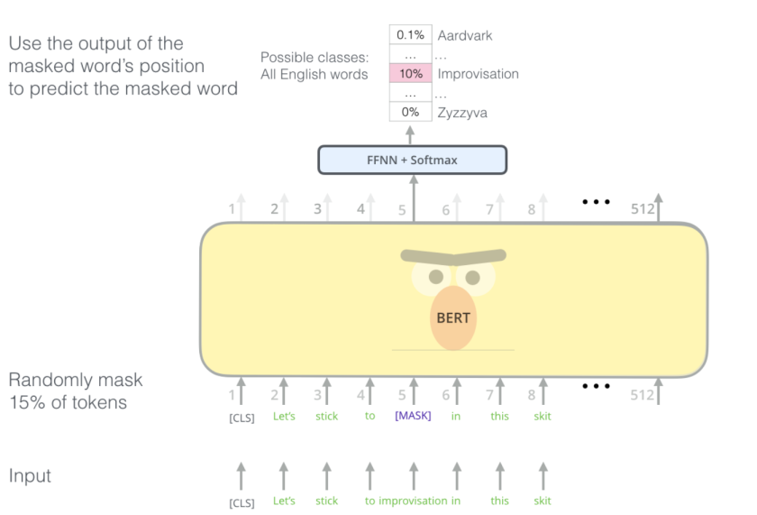

Slide 20
Next Sentence Prediction
Masked Language Models (MLMs) learn to understand the relationship between words. Additionally, BERT is also trained on the task of Next Sentence Prediction for tasks that require an understanding of the relationship between sentences.
A good example of such a task would be question answering systems.
The task is simple. Given two sentences – A and B, is B the actual next sentence that comes after A in the corpus, or just a random sentence?
Since it is a binary classification task, the data can be easily generated from any corpus by splitting it into sentence pairs. Just like MLMs, the authors have added some caveats here too. Let’s take this with an example:

Slide 21
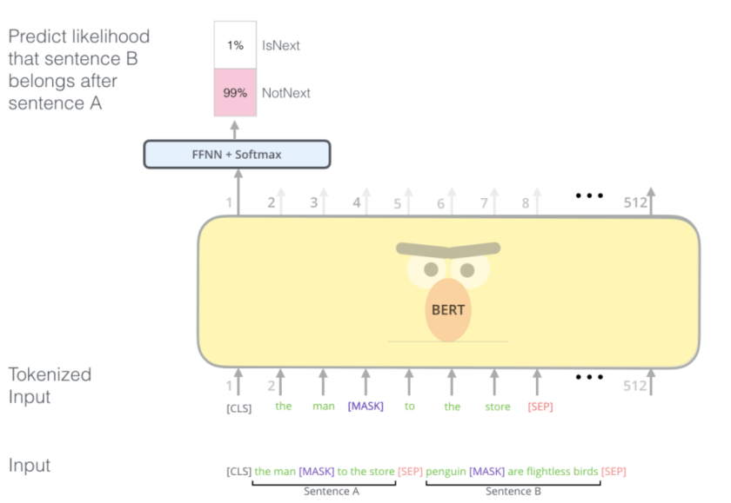

Slide 22
Consider that we have a text dataset of 100,000 sentences. So, there will be 50,000 training examples or pairs of sentences as the training data.
For 50% of the pairs, the second sentence would actually be the next sentence to the first sentence
For the remaining 50% of the pairs, the second sentence would be a random sentence from the corpus
The labels for the first case would be ‘IsNext’ and ‘NotNext’ for the second case.
To predict if the second sentence is connected to the first one or not, basically the complete input sequence goes through the Transformer based model, the output of the [CLS] token is transformed into a 2×1 shaped vector using a simple classification layer, and the IsNext-Label is assigned using softmax(mathematical function that converts a vector of numbers into a vector of probabilities).
And this is how BERT is able to become a true task-agnostic model. It combines both the Masked Language Model (MLM) and the Next Sentence Prediction (NSP) pre-training tasks.

Slide 23
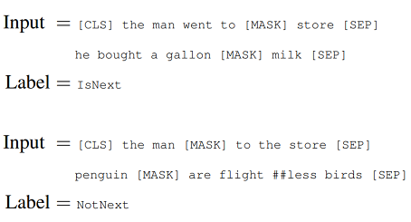

Slide 24
BERT Base: 12 layers (transformer blocks), 12 attention heads, and 110 million parameters
BERT Large: 24 layers (transformer blocks), 16 attention heads and, 340 million parameters
Fun fact:
BERT-Base was trained on 4 cloud TPUs for 4 days and BERT-Large was trained on 16 TPUs for 4 days!

Slide 25
What is BERT used for?
BERT is currently being used at Google to optimize the interpretation of user search queries. BERT excels at several functions that make this possible, including:
Sequence-to-sequence based language generation tasks such as:
Question answering
Abstract summarization
Sentence prediction
Conversational response generation
Natural language understanding tasks such as:
Polysemy and Coreference (words that sound or look the same but have different meanings) resolution
Word sense disambiguation
Natural language inference
Sentiment classification

